Slide 1
AUGUST 2021
Florida Prescription Drug Monitoring Program (PDMP) Monthly Report
This data was obtained through the Florida Prescription Drug Monitoring Program (PDMP) known as E-FORCSE. PDMPs gather information on controlled substance dispensations and use. For more information, click here.

Slide 2
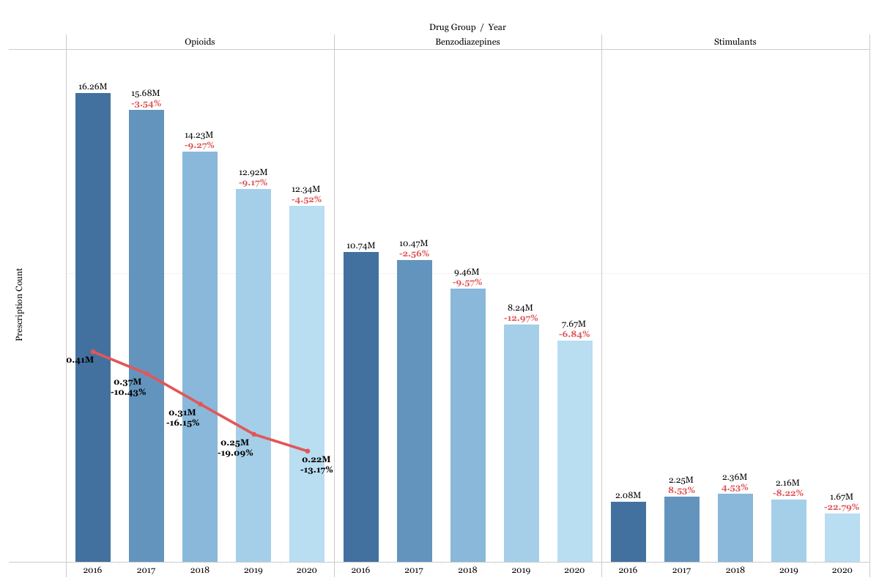
Prescriptions by Drug Type & Year, Florida, 2016 - 2020
Florida, 2016 - 2020
The red line represents the number of Fentanyl prescriptions.
The percentages indicated the percent change from the previous year.
August 2021

Slide 3
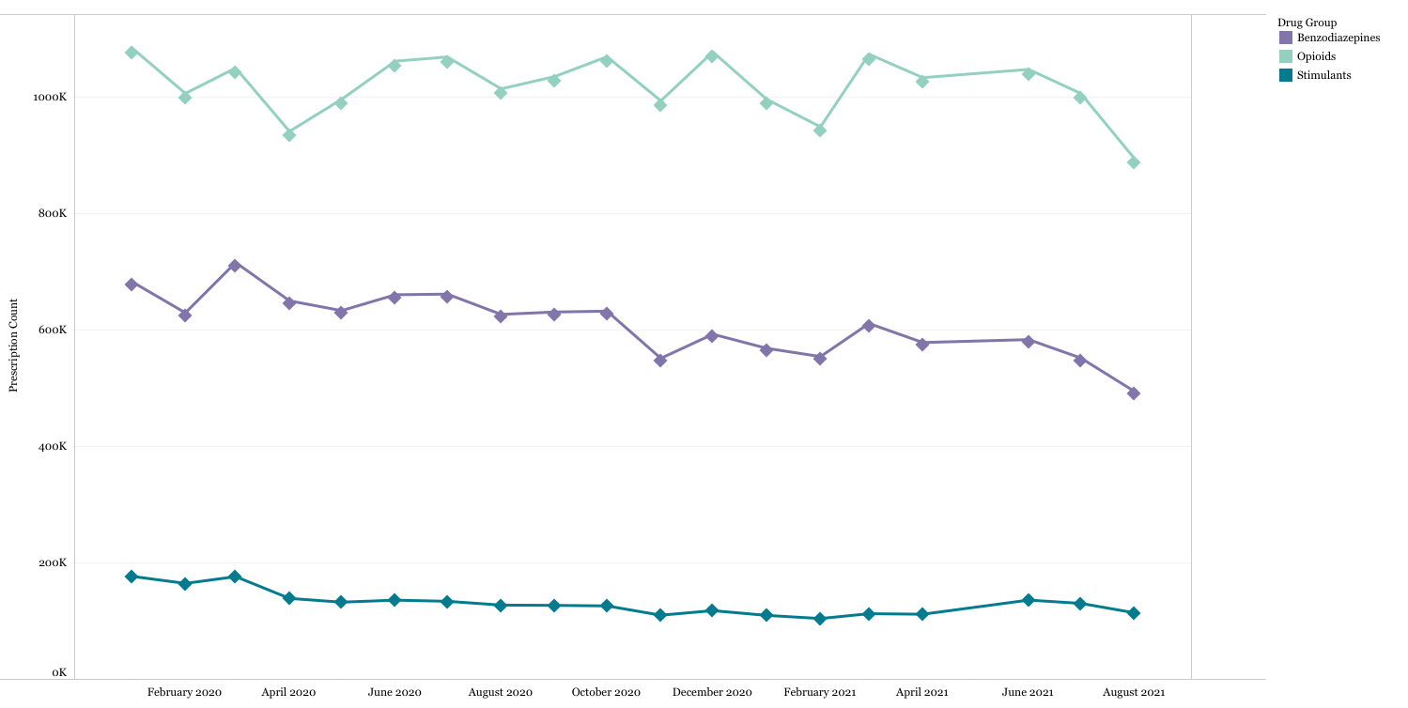
Prescriptions by Drug Type & Month
Florida, 2020 - 2021
Opioids
Benzodiazepines
Stimulants
August 2021

Slide 4
Indicators by Month
Florida, 2020 - 2021
Indicator Description | Aug 2020 | Sep 2020 | Oct 2020 | Nov 2020 | Dec 2020 | Jan 2021 | Feb 2021 | Mar 2021 | Apr 2021 | May 2021 | Jun 2021 | Jul 2021 | Aug 2021
# Opioid Prescriptions | 1,014,352 | 1,035,679 | 1,069,527 | 993,814 | 1,077,712 | 996,456 | 949,026 | 1,073,839 | 1,033,558 | 994,788 | 1,047,770 | 1,006,395 | 912,996
# Benzodiazepine Prescriptions | 626,920 | 631,018 | 632,477 | 551,482 | 592,879 | 568,694 | 554,452 | 611,288 | 578,599 | 550,211 | 583,630 | 551,951 | 507,599
# Stimulant Prescriptions | 127,557 | 127,107 | 126,167 | 110,219 | 118,074 | 109,892 | 104,478 | 112,833 | 111,880 | 113,413 | 136,168 | 130,508 | 117,421
# Opioid Patients | 782,005 | 793,222 | 811,900 | 771,322 | 805,725 | 777,040 | 749,343 | 811,670 | 797,340 | 780,716 | 804,834 | 773,640 | 716,565
# Benzodiazepine Patients | 559,558 | 561,615 | 561,427 | 493,692 | 518,568 | 512,958 | 504,739 | 536,988 | 516,812 | 496,868 | 517,047 | 491,122 | 458,300
# Stimulant Patients | 117,207 | 116,253 | 114,828 | 101,720 | 106,600 | 102,183 | 97,638 | 102,183 | 102,613 | 105,092 | 124,078 | 119,126 | 108,442
# Registered Users | 132,634 | 134,725 | 136,104 | 137,196 | 138,245 | 139,330 | 140,368 | 141,524 | 142,527 | 143,508 | 145,049 | 146,713 | 148,252
# Patient Inquiries | 3,671,301 | 3,720,140 | 3,725,433 | 3,455,257 | 3,739,624 | 3,659,877 | 3,529,604 | 3,965,548 | 3,753,303 | 3,497,707 | 3,690,995 | 3,739,980 | 3,952,774
August 2021

Slide 5
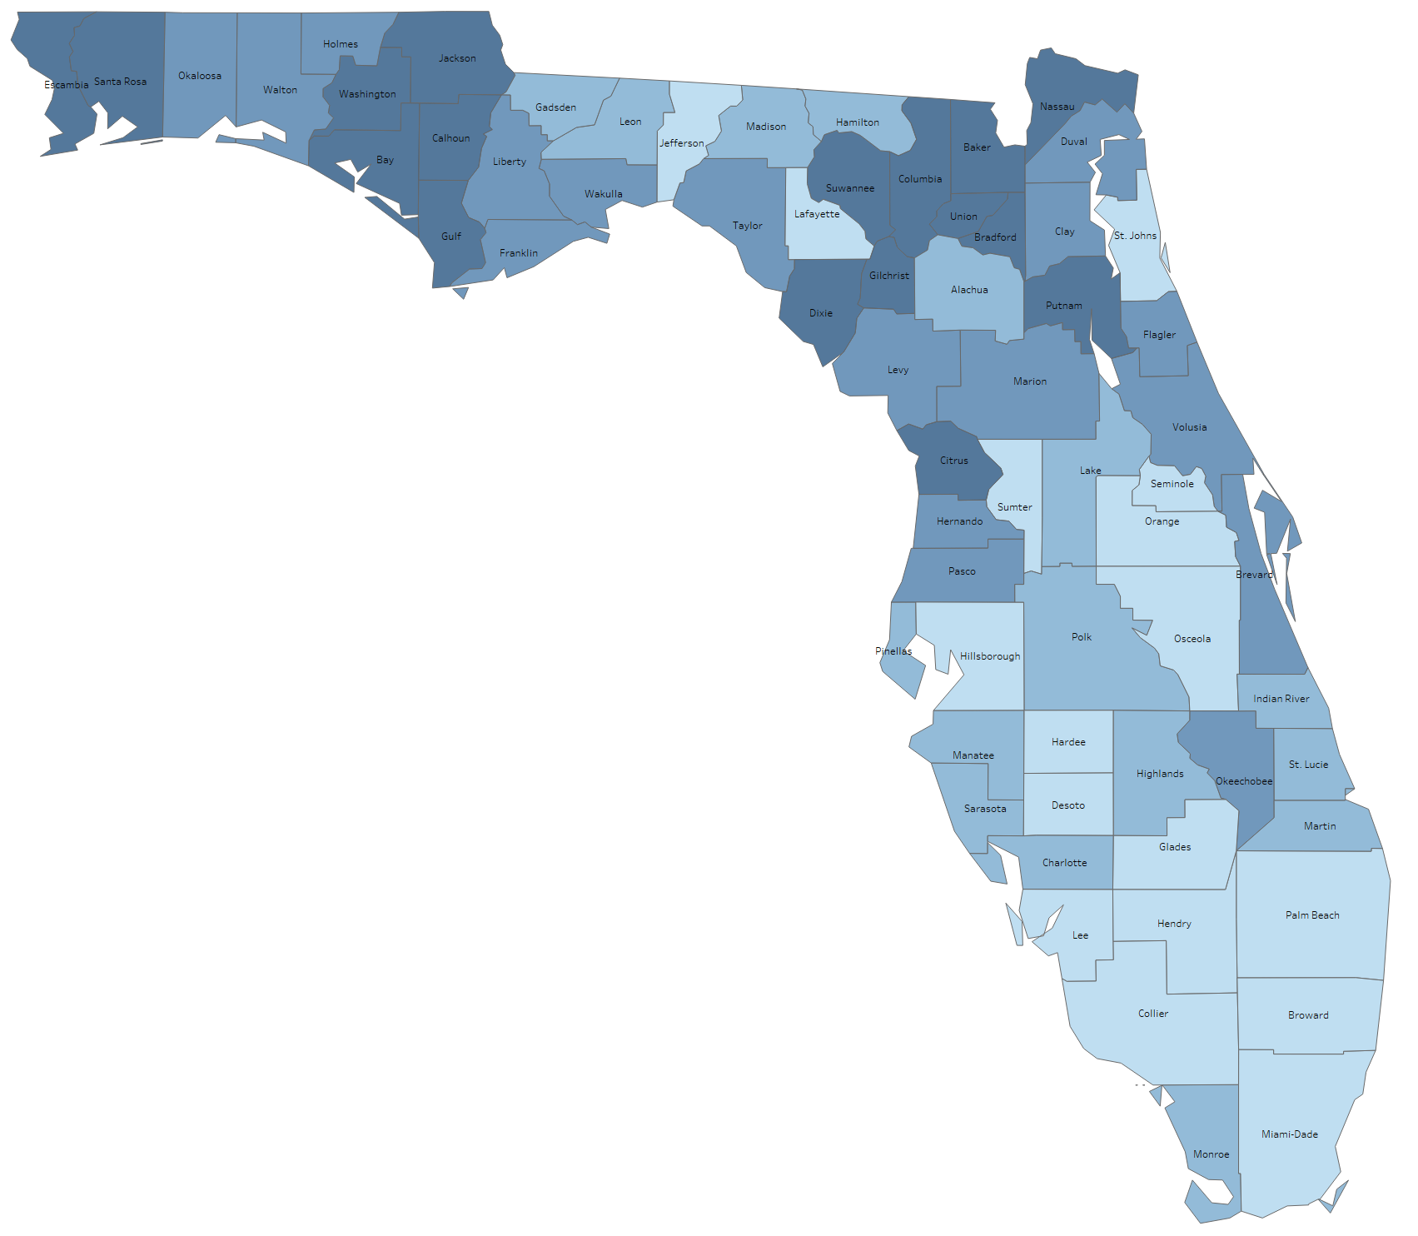
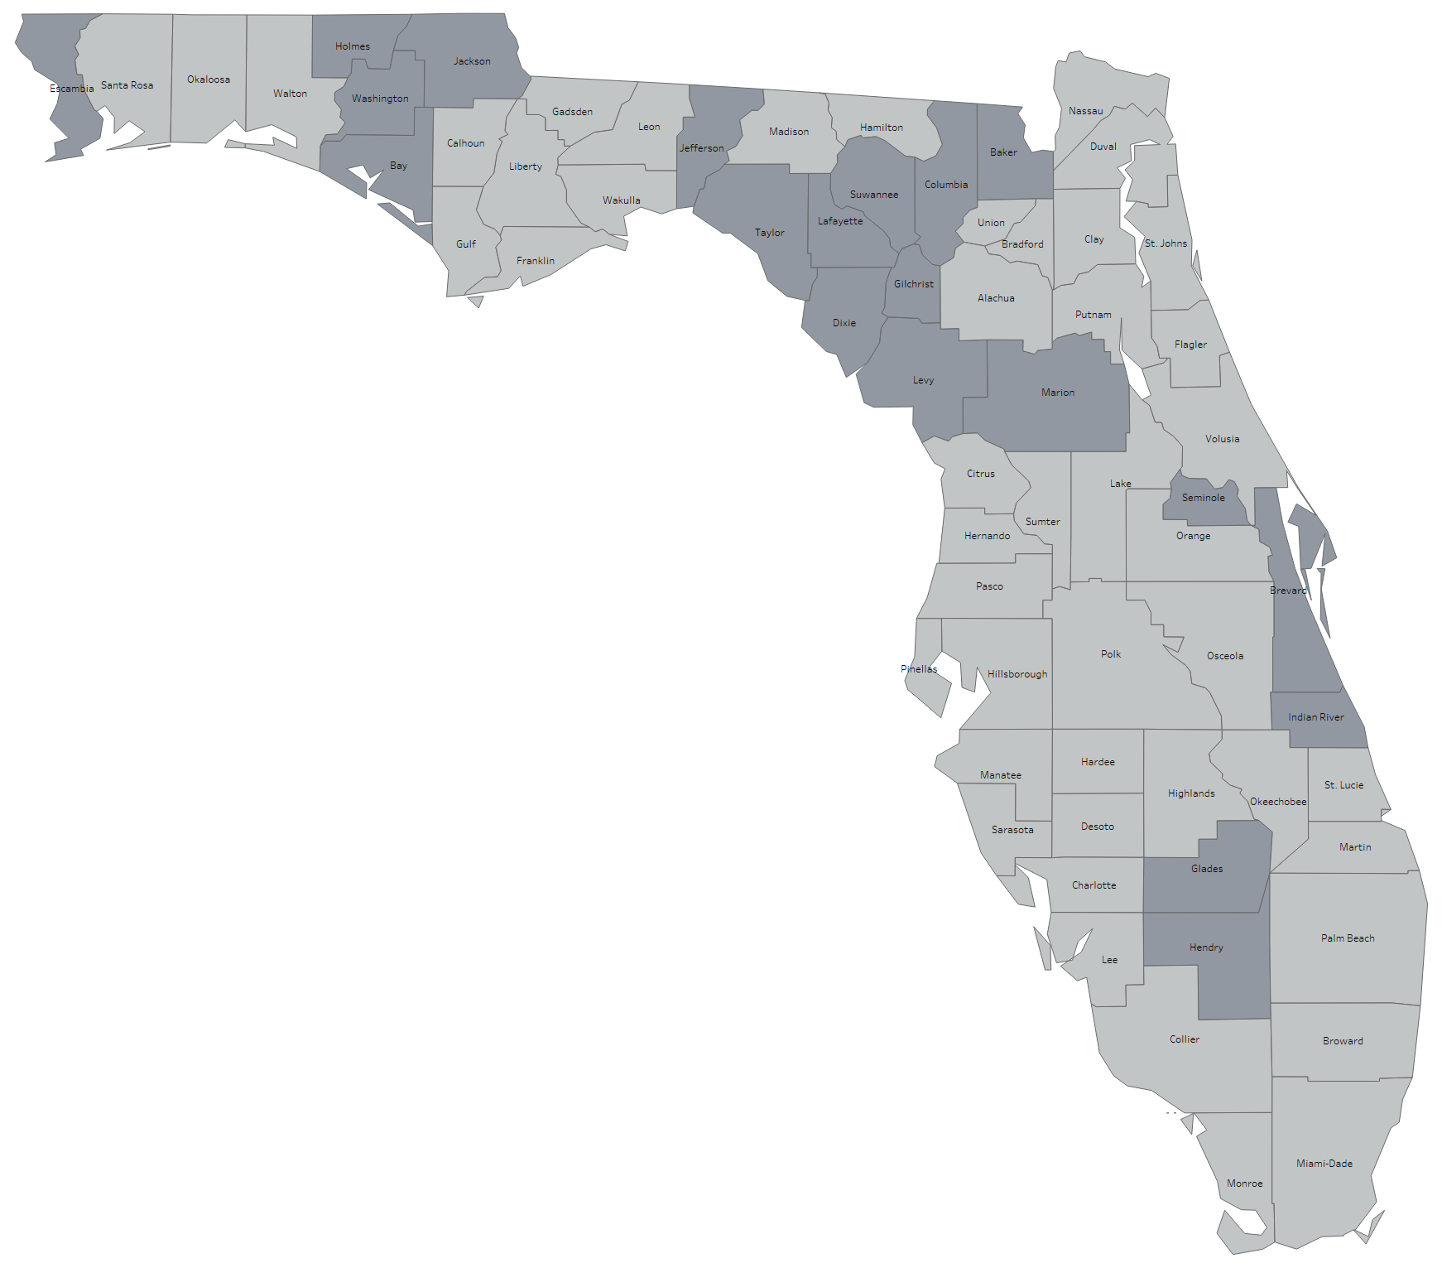
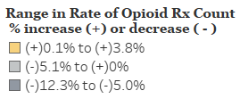
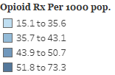
Opioid Prescription Rate & Percent Change by County
Florida, August 2021
Age-Adjusted Opioid Prescription Rate by County, Florida
August 2021
Percent Change in Opioid Prescription Count by County, Florida
Jul-Aug 2021 vs Jul-Aug 2020
August 2021

Slide 6
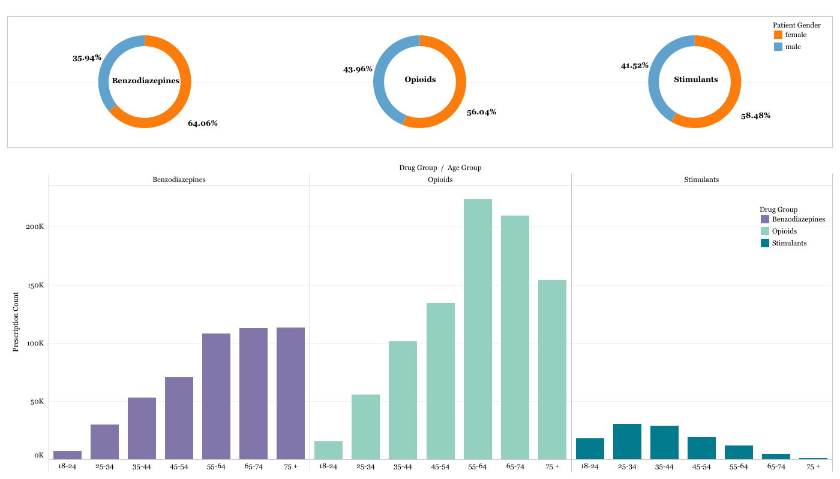
Opioid, Benzodiazepine & Stimulant Prescriptions by Sex and Age Group
Florida, August 2021
August 2021
Florida Prescription Drug Monitoring (PDMP) Monthly Report | Page 6

Slide 7
Appendix
Florida, August 2021
Opioids Include:
Benzodiazepines Include:
acetaminophen with codeine phosphate, acetaminophen/caffeine/dihydrocodeine bitartrate, acetaminophen/codeine phosphate, acetaminophen/hydrocodone bitartrate, acetaminophen/hydrocodone bitartrate, acetaminophen/oxycodone HCl, acetaminophen/oxycodone HCl, acetaminophen/tramadol HCl, aspirin/caffeine/dihydrocodeine bitartrate, buprenorphine, buprenorphine HCl, buprenorphine HCl/naloxone HCl, buprenorphine HCI, butalbital/acetaminophen/caffeine/codeine phosphate, butorphanol tartrate, carisoprodol/aspirin/codeine phosphate, codeine phosphate/butalbital/aspirin/caffeine, codeine sulfate, fentanyl, fentanyl citrate, hydrocodone bitartrate, hydrocodone bitartrate/acetaminophen, hydrocodone/ibuprofen, hydromorphone HCl, ibuprofen/oxycodone HCl, levorphanol tartrate, meperidine HCl, methadone HCl, morphine sulfate, morphine sulfate/naltrexone HCl, opium/belladonna alkaloids, oxycodone HCl, oxycodone HCl/acetaminophen, oxycodone HCl/aspirin, oxycodone HCl/oxycodone terephthalate/aspirin, oxycodone HCl, oxycodone myristate, oxymorphone HCl, pentazocine HCl/naloxone HCl, tapentadol HCl, tramadol HCl, tramadol HCl/acetaminophen, tramadol HCl.
alprazolam, amitriptyline HCl/chlordiazepoxide, chlordiazepoxide HCl, chlordiazepoxide/clidinium bromide, clobazam, clonazepam, clonazepam, clorazepate dipotassium, diazepam, estazolam, flurazepam HCl, lorazepam, oxazepam, quazepam, temazepam, triazolam.
Stimulants Include:
amphetamine, amphetamine sulfate, dexmethylphenidate HCl, dextroamphetamine sulf-saccharate/amphetamine sulf-aspartate, dextroamphetamine sulfate, lisdexamfetamine dimesylate, methylphenidate, methylphenidate HCl.
Patients who live in Florida and whose age is greater than or equal to 18 were included in this monthly report. Controlled substance drug schedule was set to II-V.
Data extraction date: 9/3/2021
August 2021

